Slide 1
News headline project
BY
M.MUGILAN(AUt810622cs20) v.SUMITHIRA(aut810622cs30)

Slide 2
TOPICS USE
API TOOL
NEWS DISPLAY
RESIGESTER
LOGIN ACTIVITY

Slide 3
PROJECT DESCRIPTION
This code snippet defines part of an API client in Kotlin using Retrofit, a type-safe HTTP client for Android and Java. The API in this example is set up to retrieve news data, specifically related to business news in the United States using the NewsAPI service. Let's break down the different parts of the code

Slide 4
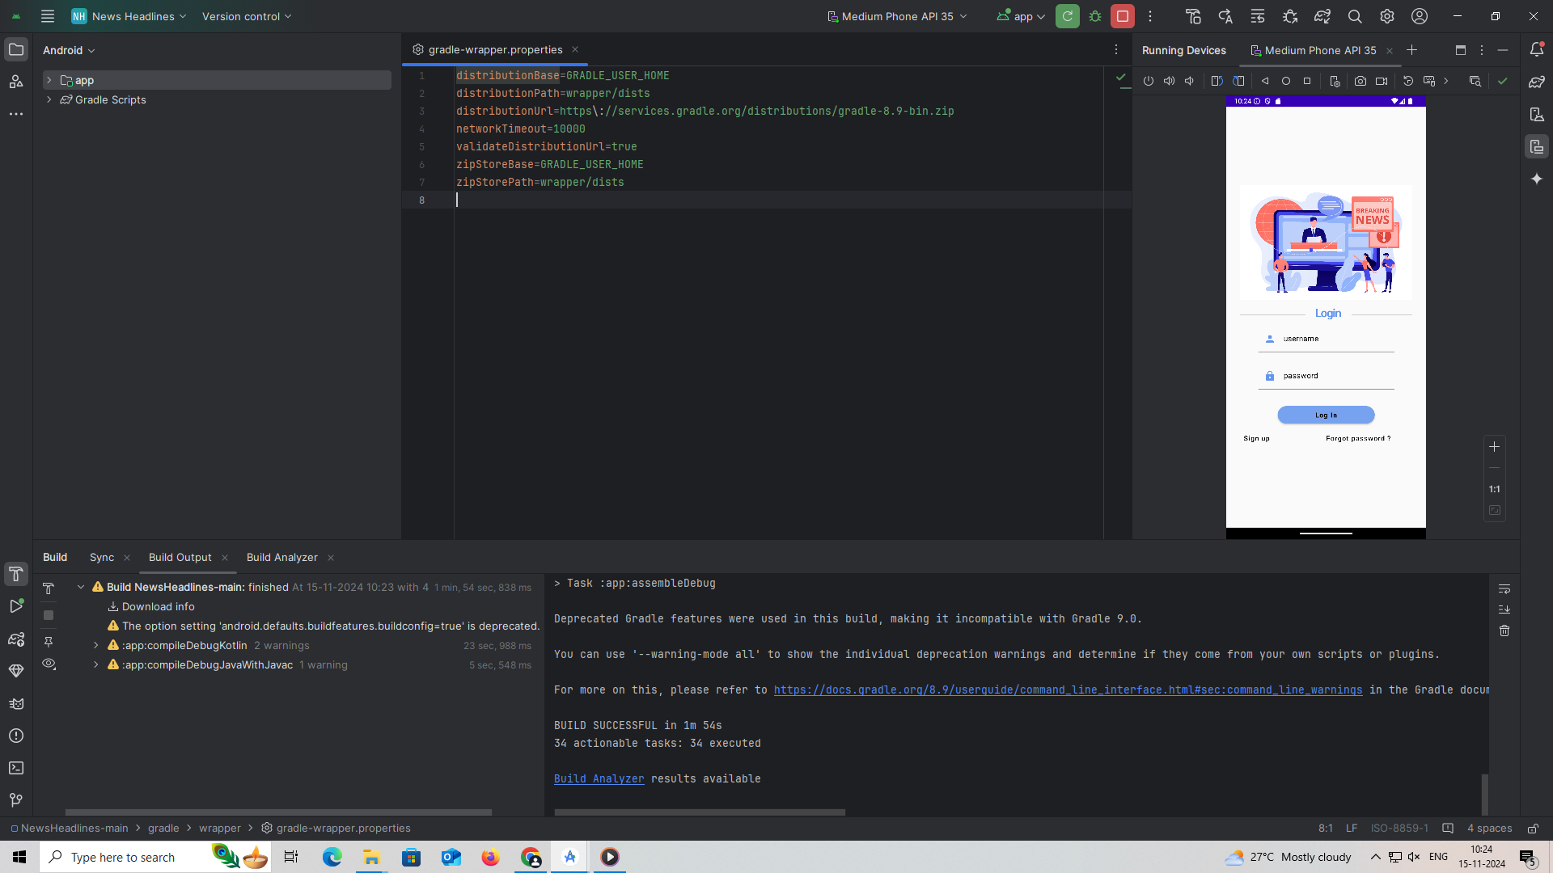
FRONT LOOK OF THE PROJECT

Slide 5
Api tool
package com.example.newsheadlines
import retrofit2.Retrofit
import retrofit2.converter.gson.GsonConverterFactory
import retrofit2.http.GET
interface ApiService {
//@GET("movielist.json")
@GET("top-headlines?country=us&category=business&apiKey=684cb893caf7425abeffad82ac1d0f4e")
///@GET("search?q=chatgpt")
suspend fun getMovies() :News
companion object {
var apiService: ApiService? = null
fun getInstance() : ApiService {
if (apiService == null) {
apiService = Retrofit.Builder()
// .baseUrl("https://howtodoandroid.com/apis/")
.baseUrl("https://newsapi.org/v2/")
//.baseUrl("https://podcast-episodes.p.rapidapi.com/")
.addConverterFactory(GsonConverterFactory.create())
.build().create(ApiService::class.java)
}
return apiService!!
}
}
}

Slide 6
LOGIC ACTIVITY

Slide 7
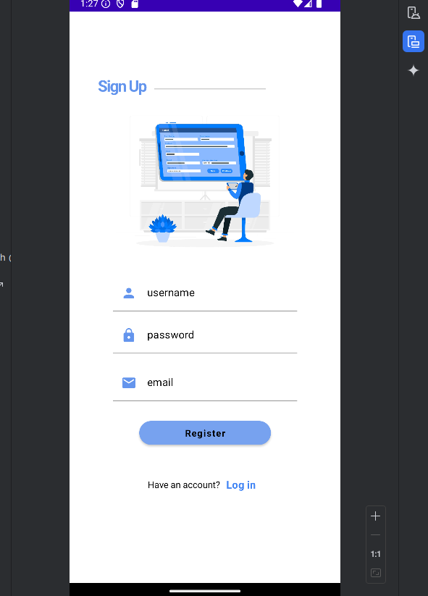
LOGIC ACTIVITY
package com.example.newsheadlines
import android.content.Context
import android.content.Intent
import android.os.Bundle
import androidx.activity.ComponentActivity
import androidx.activity.compose.setContent
import androidx.compose.foundation.Image
import androidx.compose.foundation.background
import androidx.compose.foundation.layout.*
import androidx.compose.foundation.shape.RoundedCornerShape
import androidx.compose.material.*
import androidx.compose.material.icons.Icons
import androidx.compose.material.icons.filled.Lock
import androidx.compose.material.icons.filled.Person
import androidx.compose.runtime.*
import androidx.compose.ui.Alignment
import androidx.compose.ui.Modifier
import androidx.compose.ui.graphics.Color
import androidx.compose.ui.res.painterResource
import androidx.compose.ui.text.font.FontWeight
m

Slide 8
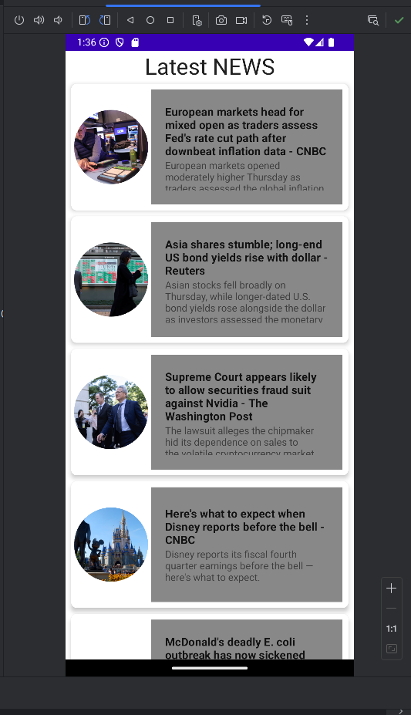
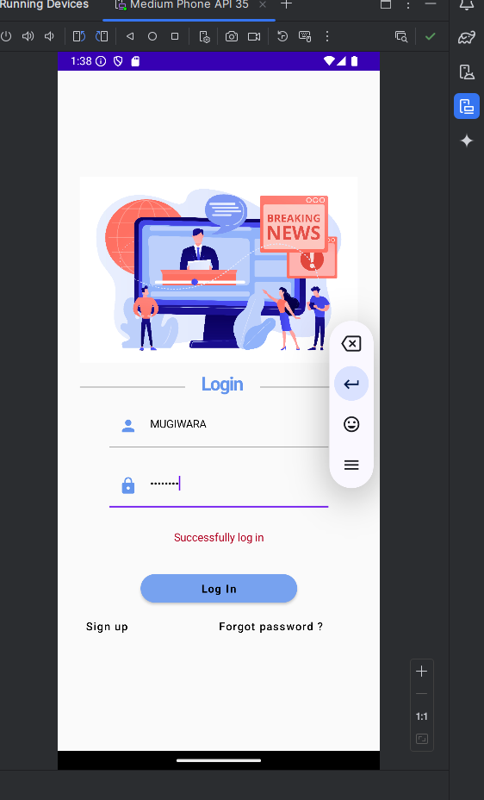
MAIN OUTPUT OF PROJECT

Slide 9
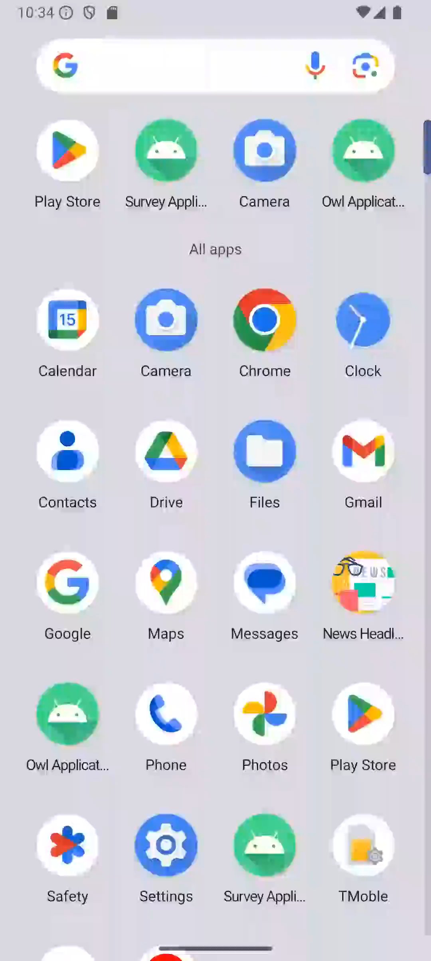
Demo video for project

Slide 10
THANK YOU
M.MUGILAN(aut810622CS20)
V.SUMITHIRA(aut810622CS30)

